Slide 1
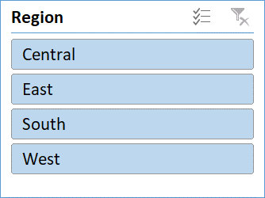
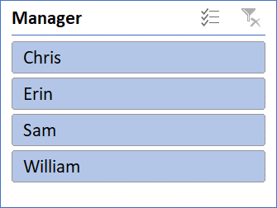
Sales Data Dashboard

Slide 2
SWOT Analysis
Strengths
Highest Sales and Profit achieved in East region
Technology has the highest sales
Opportunities
Sales must be improved in South region
Shipping cost can be reduced Washington city
Weakness
Sales and Profit in South region need attention
Threats
Less profit % in South region

Slide 3
Actionable Insights
Enhancing Sales in the South Region through effective Marketing strategies
Boosting Sales of Office Supplies Nationwide through Targeted Marketing
Reducing and Analyzing Shipping Costs in Washington through various effective initiatives
Identifying Causes of Lower Sales and profit in the South Region by comprehensive analysis
Customer Satisfaction ratios can be drawn with efficient analysis and surveys
Root cause analysis (RCA) can be conducted across various departments to identify and address any underlying issues

